Slide 1
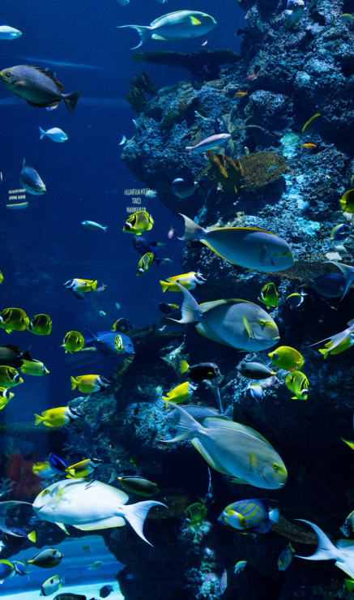
Automated Aquarium Management System ‘AquaSafe’
Team “Aqua”
A.M.Mohamed Raheethus Alfer (2020/CSC/001)
K.M.Issath (2020/CSC/021)
I.Akash Ahamed (2020/CSC/019)
Department of Computer Science,
University of Jaffna

Slide 2
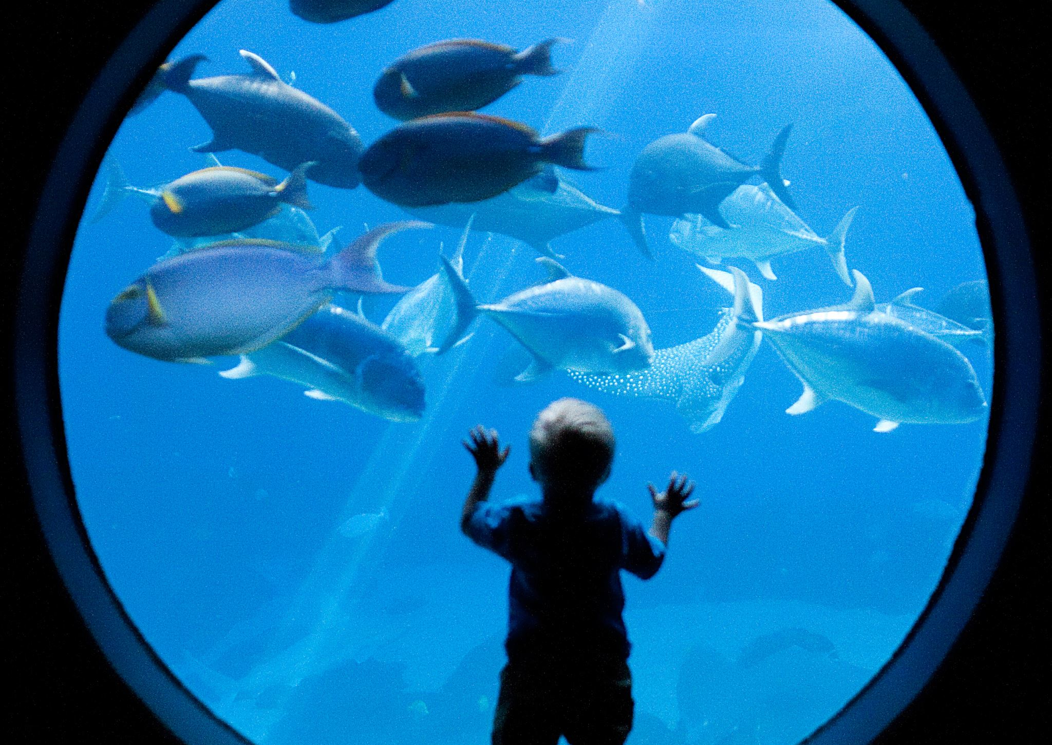
Problem Definition
Conventional aquarium management systems require caretakers
Typical Maintenance activities are tedious
Required lots of man hours for maintenance
24 hours nurturing
Human errors can threaten aqua life

Slide 3
Literature Review
Evolution of Aquarium Management
Glass aquarium invention in the 19th century
Technological advancements in filtration and monitoring
Interdisciplinary Approaches
Fish behavior and physiology models / Water chemistry and Microbiology models / IoT systems and data analytics models
Factors Affecting Fish Health
Water quality, pH, Temperature, Dissolved oxygen, electrical conductivity and total dissolved solids impact fish health

Slide 4
Identified Solution
Robust pH level regulation
Automate the feeding system
Monitoring water condition and take relevant action
Alert user through local host
Control feeding system via local host

Slide 5
Objectives
The Automated Aquarium Management System (AAMS) “AQUA SAFE” addresses the challenges faced by aquarium owners by automating essential tasks and optimizing the aquatic environment.
Key Objectives
pH level regulation
Maintaining pH within the habitable range
Maintaining water level
Ensuring an adequate water level through ultrasonic sensors
Monitoring water temperature
Constantly monitoring water temperature for fish health
Feeding system
Automating fish feeding to maintain a healthy ecosystem

Slide 6
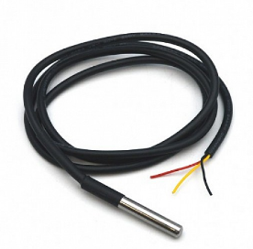
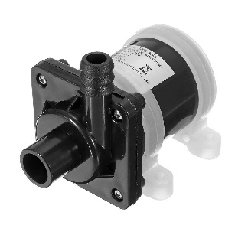
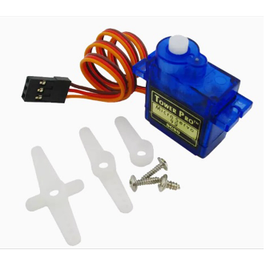
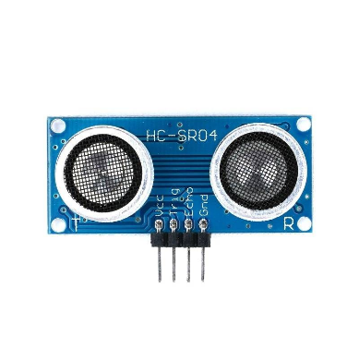
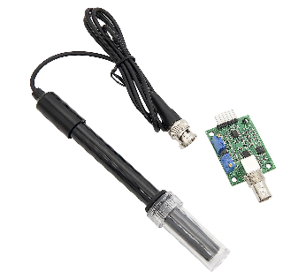
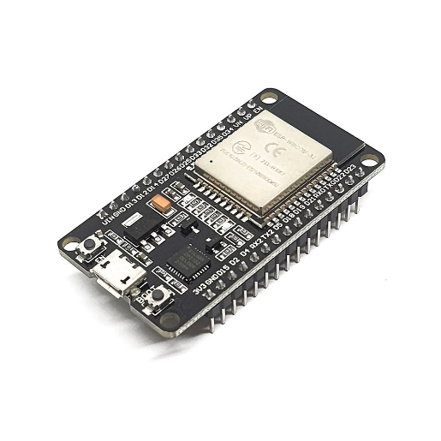
Components Used
Temperature Sensor - DS18B20
pH Sensor - E201
Ultrasonic Sensor - HC-SR04
Servo Motor - SG90
ESP32 Development Board
12V DC Pumps
Relays

Slide 7
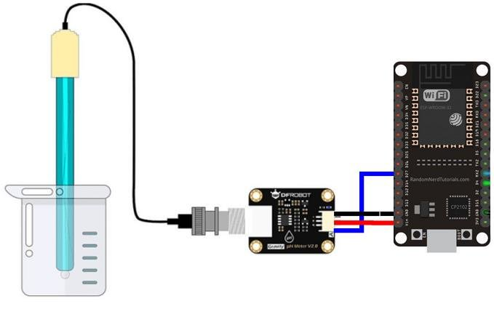
Solution Developed to Regulate pH
Components Used
pH sensor(E201) - To measure the pH of the water
Ultrasonic Sensor(HCSR04) - To measure the water level
Relays - To on/off pump from ESP32
Pumps - To fill/remove water
Proposed Method
Measure the pH value and compare it with the threshold value
If the pH is not in the predefined range, then turn on pump 1.
Measure the water level.
If the water level is lower than predefined value, turn off pump 1 and turn on pump 2.
Measure the water level.
If the water level is higher than predefined value, turn off pump 2.
Repeat…

Slide 8
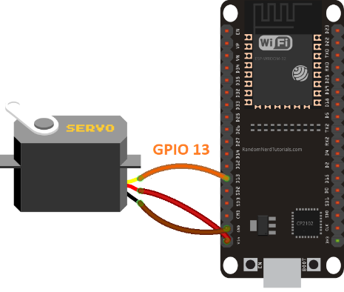
Solution Developed to Feeding System
Components Used
Servo Motor (SG90) - To open/close the feeding system lid.
Proposed Method
Compare current time with last feeded time.
Open the lid if the difference is greater than user defined value.
Close the lid after 10s.
Look for web command to open the feeder lid.
Open feeder lid according to web command.

Slide 9
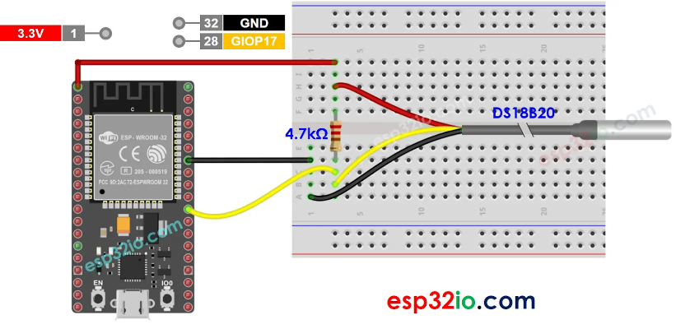
Solution Developed to Measure Temperature
Components Used
Temperature sensor(DS18B20) - To measure the temperature
Proposed Method
Measure temperature of the water.
Update the temperature value to a web server.
Repeat…

Slide 10
Control and MCU
MCU Used
ESP32
Proposed Method
Connect ESP32 to web.
Look for web requests.
Run the feeder system, water changing system and temperature sensor

Slide 11
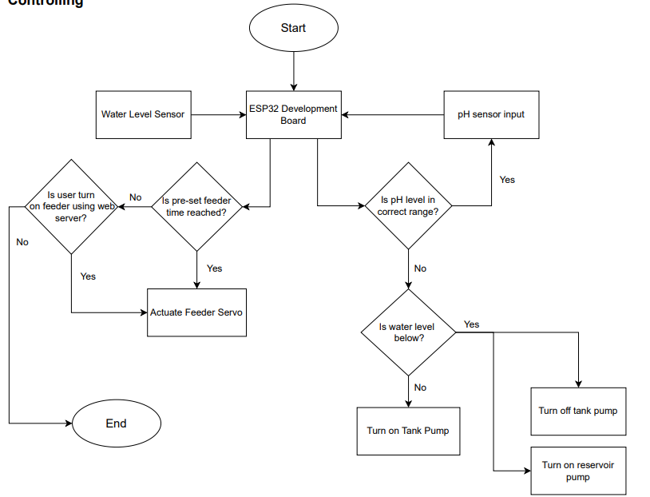
Program Logic

Slide 12
Pin Configuration used with ESP32

Slide 13

Program and the code
The program codes:
Arduino (C++) code:
Responsible for controlling the aquarium's sensors and actuators.

Slide 14
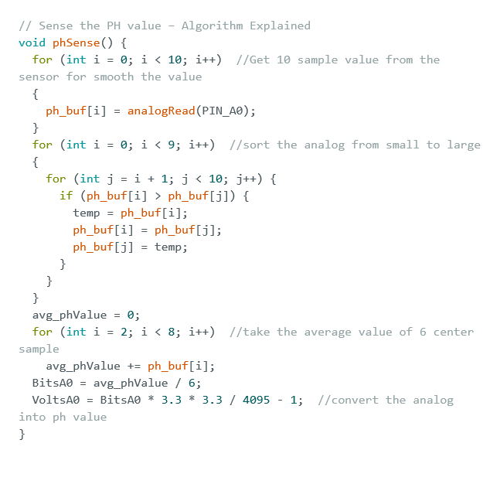
Arduino program for the pH sensor (E-201)

Slide 15
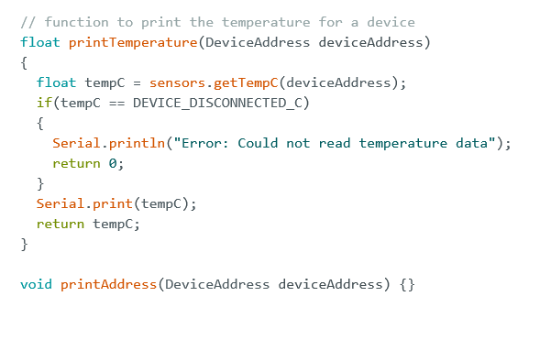
Arduino program for the Temperature sensor (DS18B20)

Slide 16
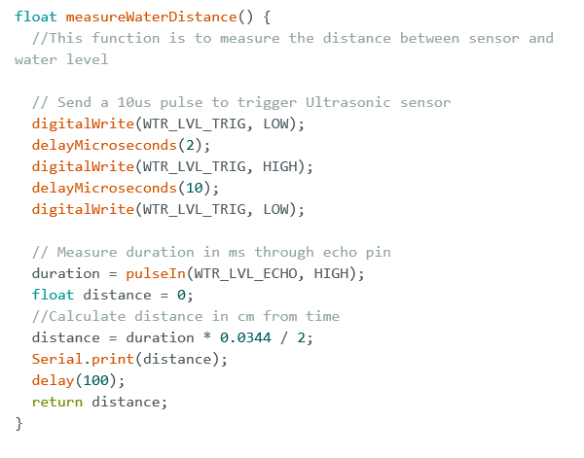
Arduino Program for the Ultrasonic Sensor

Slide 17
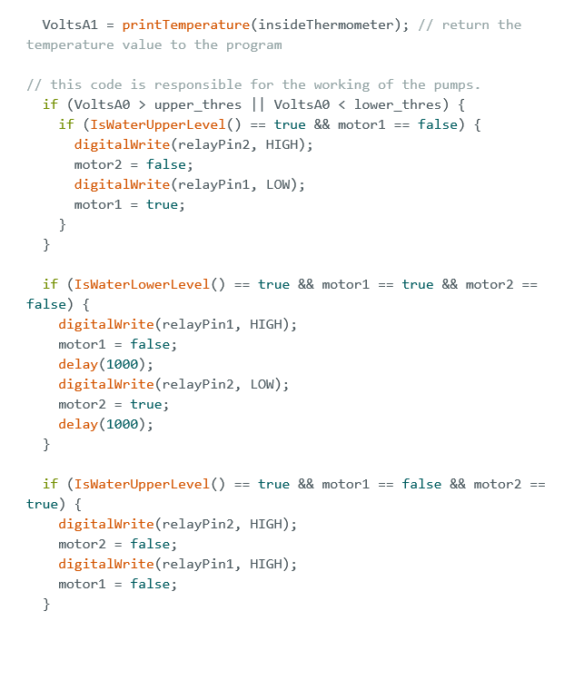
Arduino Program for Pumps (12V 2 Relay)

Slide 18
Tinkercad link
We utilized Tinkercad components for the implementation of this project. However, since Tinkercad lacks certain components, we were unable to fully realize the project, using only the available components within the platform.
https://www.tinkercad.com/things/alnMJuT777o-raheethus-alfer/editel?sharecode=fga9-ktEqOrySDAYejhLyR8sOkAioy-UcgfjpWN-qkY

Slide 19
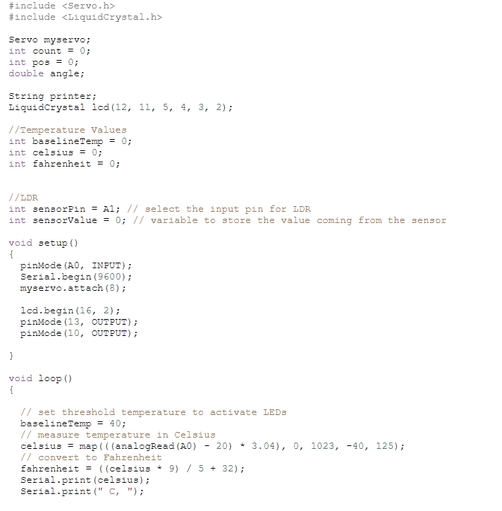
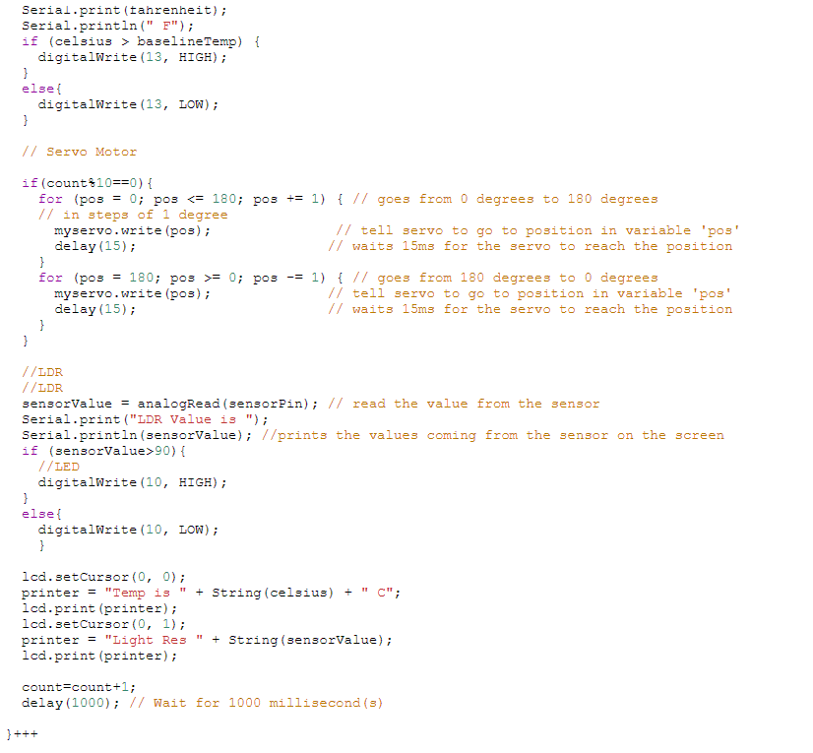
Arduino Program for Full Code

Slide 20
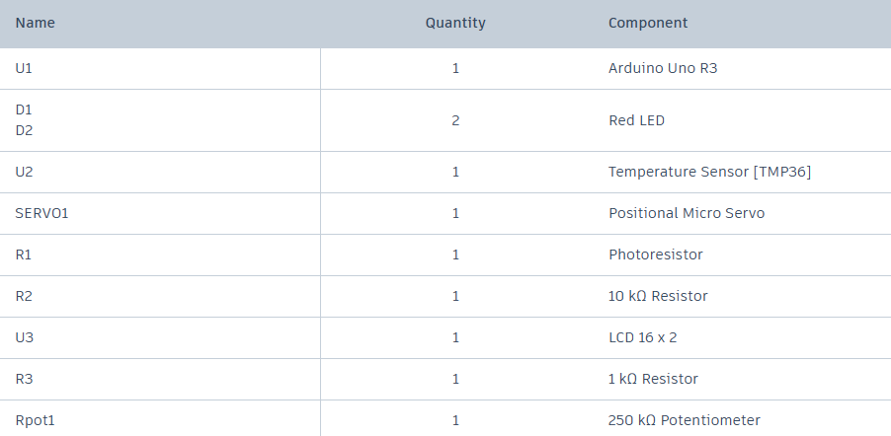
Pin Configuration used with Arduino

Slide 21


Initializing Connection

Slide 22
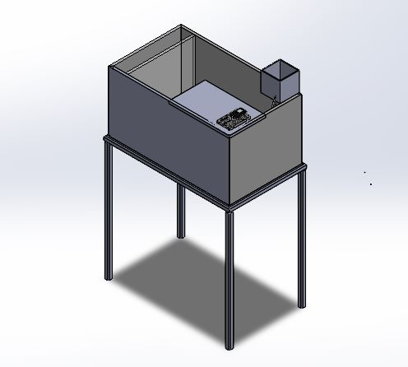
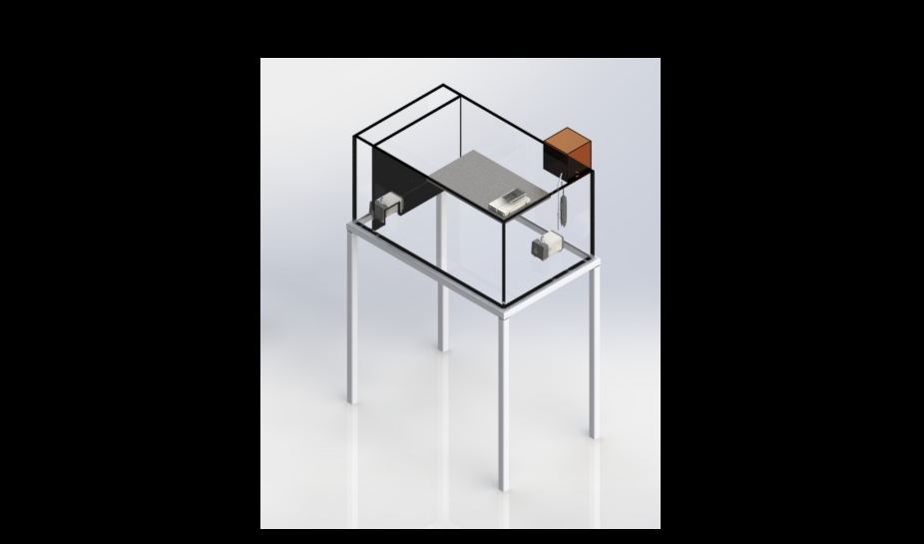
System Setup

Slide 23
Future Improvements
Tank Refilling and Temperature
Make the system sensitive to temperature changes
Feeding Mechanism
Larger food particles, Liquid foods, Different types of food.
Food Level Indication
Container food level indication
Water Reservoir Monitoring
Monitoring the pH value and temperature of the reservoir
Enhance Feeding Functionality
Database of feeding cycle for different fish breeds.
Inflow and Outflow Rates
Using a pump with variable flow rate

Slide 24
Thank You

